Slide 1

LINK BETWEEN FORECAST TO COMPLETE & ACCOUNTING SYSTEM
SOME
IMPORTANT ASPECTS
OF THE COST CONTROL
Salerno’s srl PROCEDURE
E-mail:info@salernocompany.com

Slide 2
INDEX
PREPARE THE BUDGET
ACTUALIZE COSTS
COMMITMENT & FORECAST
REPORTING & INDICATORS
Legend:
ADM = Administration
PM= Project Manger
CM= Construction Manager
PC= Procurement Coordinator
PRS= Project Revenue Schedule
PL= Project Leader

Slide 3

Chapter 1
PREPARE THE BUDGET

Slide 4
OPENING A NEW PROJECT
ESSENTIAL INPUT DATA
Opening of the project (ONS= Order Notification Sheet) with data regarding Revenue-Cost-Margin-Duration of the project)
Initial Budget (from proposal estimate) of the costs if possible with quantity survey of materials.
Copy of the contract

Slide 5
ACTIONS TAKEN BY THE COST CONTROLLER: (Operative Budget)
Analysis of the proposal estimate in co-ordination with the P.M.: considerations on costs not included and increase of the hourly rates for the following years (Transfer Budget).
Preparation of the new operative Budget keeping the project margin unchanged. Preparation of the COSTS and SUMMARY charts (divided by Home Office-Materials-Construction: With details on type of cost and cost account).

Slide 6
(P.R.S.)Project Revenues Schedule - Engineering
Scheduling of Costs-Revenues- Invoicing by:
Engineering Costs:
Internal Engineering in conformity with the Engineering Project Plan (by P.L. & Planner) the assignment chart (by PM).
External Engineering according to estimated physical progress (by P.L. & Planner).

Slide 7
(P.R.S.)Project Revenues Schedule - Materials
Scheduling of Costs-Revenues- Invoicing by:
Materials Costs:
According to estimated procurement cycle (by Planner-Procurement co ordinator ) preparation of the “MATER” chart for estimate of commitment and incoming costs

Slide 8
(P.R.S.)Project Revenues Schedule - Site Costs
Scheduling of Costs-Revenues- Invoicing by:
Site Costs:
According to construction schedule (by C.M. & Planner) with estimate based on quantity, standard performance, of the standard man-hours and estimated physical progress.

Slide 9
(P.R.S.)Project Revenues Schedule - Other Costs
Scheduling of Costs-Revenues- Invoicing by:
Other costs:
All other costs are distributed linearly and according to the duration of the activities.
Unexpected technical events and contingencies are always accounted for in the last month of the duration of the project.

Slide 10
Chapter 2
ACTUALIZE COSTS

Slide 11

UPDATING AND MONITORING THE PROJECT : (COST CONTROL) I part
On the seventh day of each month, Salerno must received from the Client Company the information needed to update the work plan.
The cost controller must received the following information to be able to update and analyse the economic values:
From ADM/P.M. Internal / External spent man-hours
Update costs of
direct and indirect
resources
From engineering Updated Engineering project plan
Physical progress
(documents issued and to
be issued; estimate to
complete)
From C.M. quantity performed and direct man-hours
Equivalent construction physical progress, analysis of current performance and the resulting efficiency / efficacy analysis and estimate to complete

Slide 12
UPDATING AND MONITORING THE PROJECT : (COST CONTROL) – II part
The cost controller must received the following information to be able to update and analyse the economic values:
From Procurement Coordinator / Planner
Materials:
List of items to be purchased (in accordance with the
Schedule and master order)
Isued Orders:For significant items and Bulk Materials:
Order amount
Type of contract
Invoicing events and method of payment
For orders to be issued:
Estimated date of issue → COMMITMENT
Estimated delivery data → REVENUE

Slide 13



UPDATING AND MONITORING THE PROJECT : (COST CONTROL) – III part
All the input above will allow cost control to analyse in detail the revenues: a possibility to anticipate the monthly costs, especially those of the materials if manufacture and testing are communicated in time, and possible savings (unexpected technical event) on the items purchased
On the 15 ^{th} day of each month the administration will send the provisional economic situation that is to be recorded and analysed by Cost Control which in turn will notify, in co ordination with the P.M. , the actions to be taken before final release of such information.
A cycle so well organized allows issue of a cost control report updated in real time and with a reliable forecast for the following month

Slide 14

CONSIDERATIONS
A Better analysis of the procurement cycle could be achieved by operating at the material requisition level receiving a copy of the supply requests properly filled out.
EXTRA WORKS:
Office:
Site
Engineering → hourly commitment
Materials → items and estimated costs
Manpower → hourly commitment
Construction → type of contract
→ Construction hours
Commissioning → hourly commitment

Slide 15
ACTUAL COSTS
ACTUAL ENGINEERING COST = ACCOUNTING MANHOURS X UPDATED HOURLY RATE
ACTUAL MATERIAL COSTS = INVOICES RECEIVED (MONTHLY)
ACTUAL CONSTRUCTION COSTS = INVOICES (WORK PROGRESS) INCOME (MONTHLY)
ACTIVE BILLING
ACCORDING TO THE CONTRACT IN THE PRS IT IS NECESSARY TO ESTIMATE:
ENTRY OF THE COST MONTH BY MONTH
ACTIVE BILLING MONTH BY MONTH.
ALL ESTIMATED ACTUAL AND FORECAST

Slide 16
Chapter 3
COMMITMENT / FORECAST

Slide 17
COMMITMENT COSTS
INTERNAL ENGINEERING
EXTERNAL ENGINEERING
SPENT MANHOURS X RATE UPDATED HOURS (MONTHLY AND ACCUMULATED)
SUBCONTRACT WORK
MATERIALS = UPDATED COSTS ISSUED ORDERS (MONTHLY AND ACCUMULATED)
CONSTRUCTION SUBCONTRACT = % PHYSICAL PROGRESS X TOTAL COST SUBCONTRACTS
CONSTRUCTION DIRECT HIRING
MANHOURS SPENT X HOURLY RATE (MONTHLY AND ACCUMULATED
COMMISSIONING
FORECAST COSTS
ESTIMATED MATERIALS TO COMPLETE = ORDERS TO BE ISSUED
TOTAL EXPECTED MATERIALS = COMMITMENT PLUS TO BE COMMITED
EXPECTED TOTAL COSTS = COMMITMENT PLUS ESTIMATE TO COMPLETE

Slide 18
Chapter 4
REPORTING / INDICATORS
Legend:
ADM = Administration
PM= Project Manger
CM= Construction Manager
PC= Project Co-Ordinator
PRS= Project Revenue Schedule
PL= Project Leader

Slide 19
OUTPUTs:
CHARTS: Summary charts emphasising essential project data:
REVENUES COSTS MARGIN INVOICED (events) and charts that give a hint of the year-end revenue compared with the company target.
GRAPHICS: Such scheduling generates charts detailed in time (CURVES) that in turn generate GRAPHICS that give a hint of the project performance.
REPORTING :Issue of the project Progress Report

Slide 20
Example of Material Commitment/Cost schedule

Slide 21
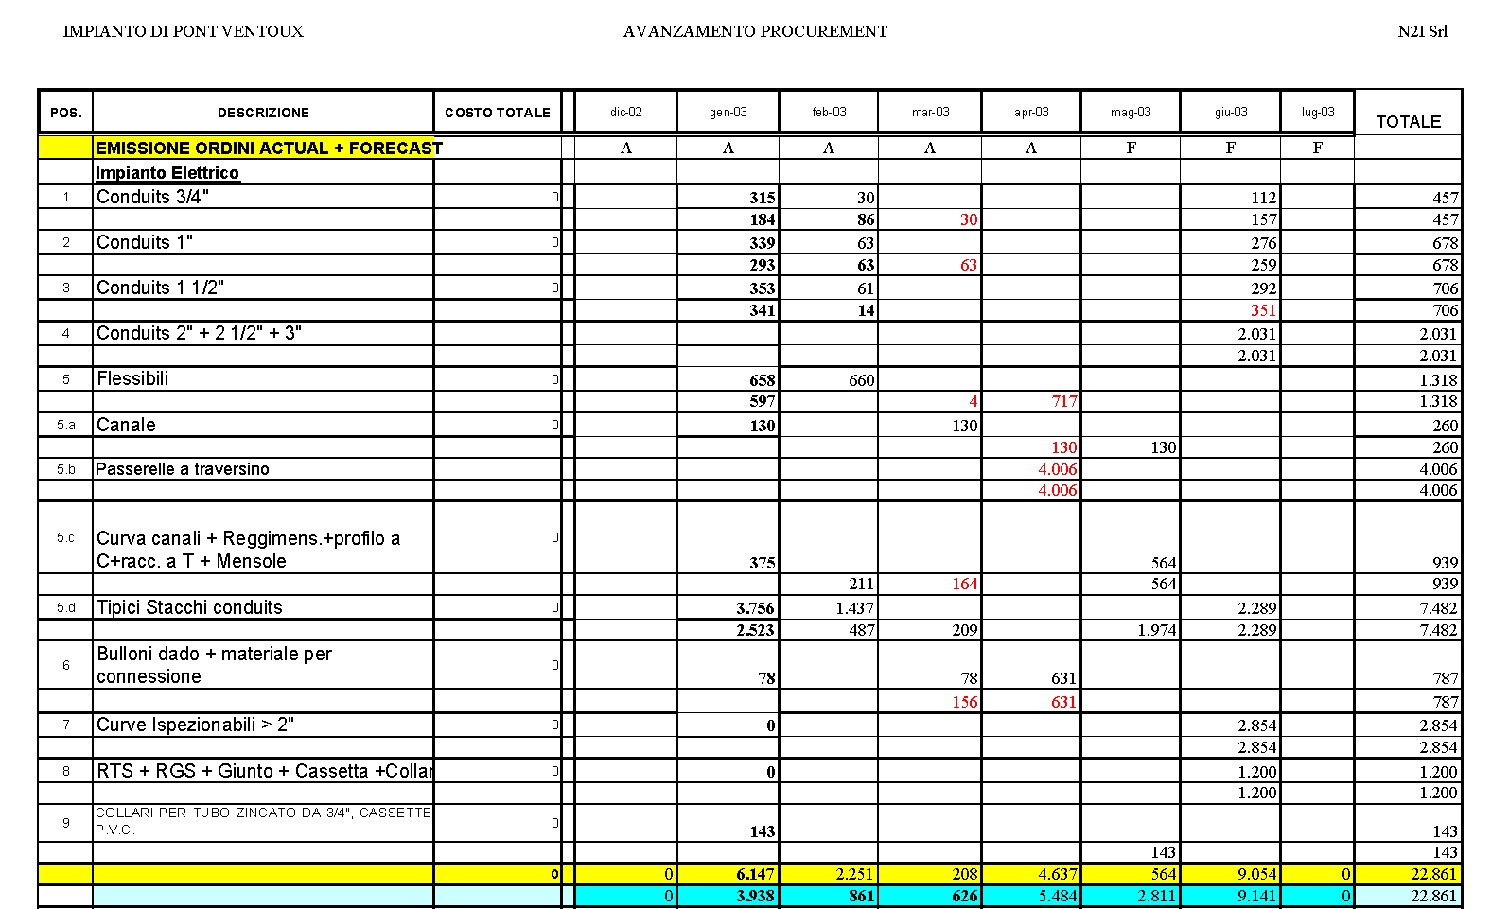
Material Commitment/Cost schedule

Slide 22
Example of Budget - Actual – Forecast – Earned
Manhours “S” Curve

Slide 24
Example of Summary Cost Control

Slide 25
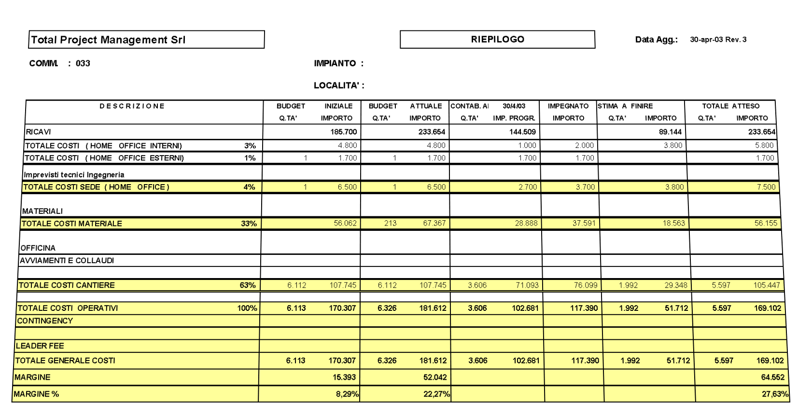

Slide 26
Example: Revenue – Costs – Billing – Gross Margin Curves

Slide 27
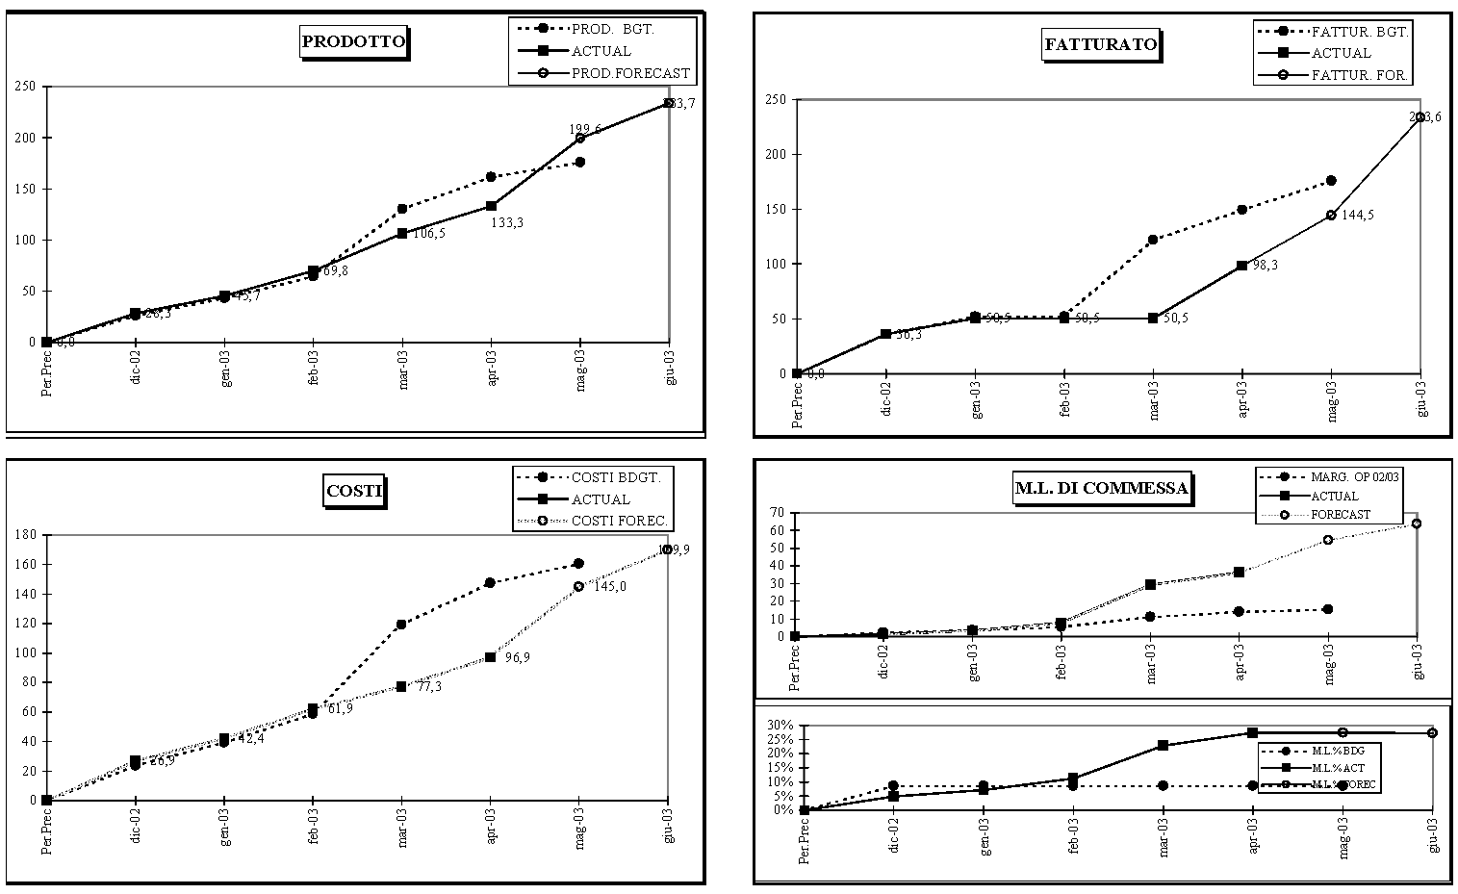
Example: Revenue – Costs – Billing – Gross Margin Curves

Slide 28
Example: Project Revenue Schedule

Slide 29
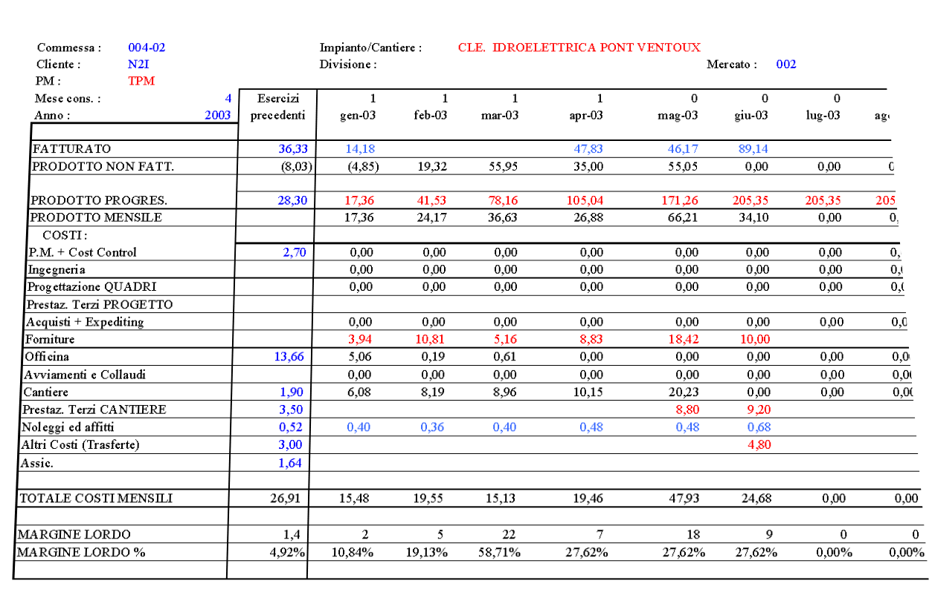

Slide 30
ELEMENTS & INDICATORS FOR COST CONTROL:
REVENUE = COST (ACCUMULATED TO DATE ) X ESTIMATED TOTAL REVENUES ESTIMATED TOTAL COSTS
GROSS PROFIT (MONTHLY AND ACCUMULATED)
M.L= ACTUAL (REVENUES TO DATE – COSTS TO DATE)
M.L = ESTIMATED (ESTIMATED REVENUES – ESTIMATED COSTS)
MARGIN PERCENT (MONTHLY AND ACCUMULATED)
M % ACTUAL = ACTUAL ACCUMULATED REVENUE – ACTUAL ACCUMULATED COSTS
ACTUAL ACCUMULATED REVENUES
M % ESTIMATED = ESTIMATED TOTAL REVENUES – ESTIMATED TOTAL COSTS
ESTIMATED TOTAL REVENUES
WIP (Work In Progress) = REVENUE – INVOICED
Positive when the amount invoiced is less of what already expended

Slide 31
ESEMPI
ESEMPIO 1 – TABELLA RICAVI
ESEMPIO 2 – RIEPILOGO COSTI
ESEMPIO 3 – CONTROLLO COSTI
ESEMPIO 4 – PROJECT REVENUE SCHEDULE
ESEMPIO 5 – CASH FLOW

